Slide 2
Solution for mask and temperature detection for large gatherings
Mentored By:
Mr. Anurag Jain
Assistant Professor (SG)
Department of Virtualization

Slide 3
Team Members & Role
Name | S.A.P.
Aanchal Sharma | 500067964
Aman Sharma | 500067893
Arnav Sharma | 500068756
Gaurvendra Singh | 500068385

Slide 4

Topics Covered
Introduction
Problem Statement
Purpose
Objectives
Methodology
Flow chart
Features
Software/ Hardware Requirements
Results and Discussions
Timeline (PERT CHART)
To Do…
References

Slide 5
Introduction
In this project, we have developed a Realtime the mask detection model can be said to be a combination of classification and face detection model. For the purpose of classification, we use transfer learning with an Xception model trained on the ImageNet dataset with a modified final fully connected layer. While using the face detection model, several different approaches were tried upon based on existing literature, and the one which worked the best was a RetinaNet Face pre-trained model which gave the highest measures of recall while experimenting on different use-cases and testing images of people in a crowded setting. The models and implementation details for them have been discussed in an objective manner as part of this section, and while providing an insight on the approach used (and why it was chosen in the first place), we delve into our final mask detection model which was built using a combination of the classification and face detection models as were briefly described above.

Slide 6
Problem Statement
For large crowds, manual mask and temperature is a time-consuming and inaccurate approach to use. Design and develop a solution for mask and temperature detection for large gatherings.

Slide 7
Purpose
Currently, we have 476 million confirmed cases and near 6 million deaths worldwide due to the coronavirus pandemic. While some factors can be eluded as being not being under our control as individuals, we cannot say that face masks do not have a big role to play in controlling this pandemic. Upon wearing the face mask, we as the source of infection reduce the number of droplets ejected by 99 percent according to confirmed studies, and if we reduce the number of people getting infected, it also reduces the effective reproduction rate, and hence having an impact of exponential margins. Nearly half of the infected people do not show symptoms as per recent studies, which can take up to a period of 14 days to appear in an infected individual. Hence, it is really necessary for wearing masks by people in public places, and should really be made mandatory rather than being based on individual decisions, as a significant portion of people with infection lack coronavirus symptoms.

Slide 8
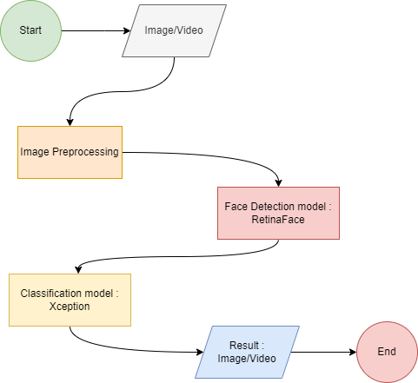
Flow Chart

Slide 9
Methodology
On any given test image of a crowd based setting of people, our final mask detection model runs as follows:
Apply the RetinaNet Face model for face detection to generate detected face crops from the input image.
Xception model for classification into mask and no-mask categories for the detected face is applied upon the detections generated by RetinaNet model.
The final output of these two would be the faces detected by RetinaNet along with the predicted category for each face, that is whether the subject is wearing a mask or not.

Slide 10
Objectives
Creation of Web based application
➢ Sub Objectives:
● Creation of Front-End.
● Creation of Deployable ML model.

Slide 11

Features
Written in Python
Interactive and user friendly interface.
Can be used to large gathering.
Highly precise and accurate.
Real Time Monitoring.

Slide 12
Software/ Hardware Requirement
Hardware:
RAM: 8 GiB
Disk Space: 1GiB (min)
GPU
Software:
Visual Studios
Operating System:
LINUX/WINDOW/OSX
Resources:
TensorFlow/Keras
Pytorch

Slide 13
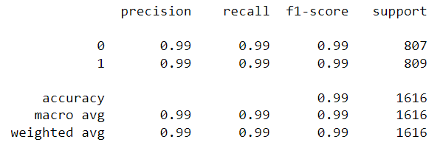
Results and Discussion
1. Results obtained on the classification model:

Slide 14
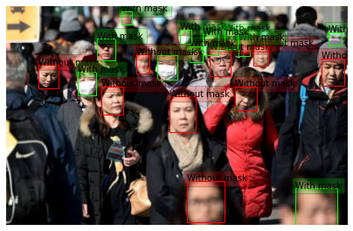
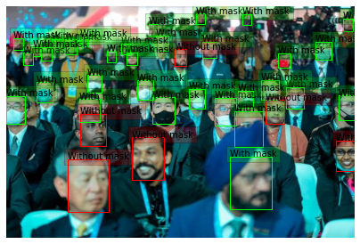
2. Results on test images

Slide 15
2. Results on test Video

Slide 16
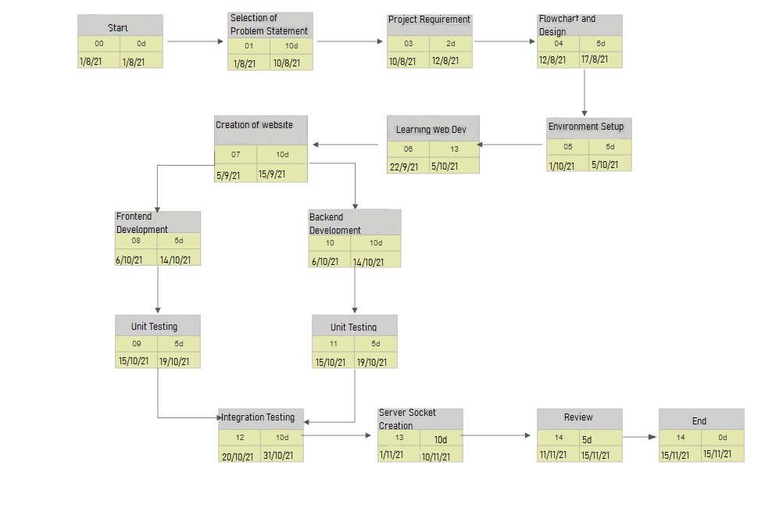
Pert Chart

Slide 17



To-Do
Containerization and Deployment
Implementation of thermal screening / Temperature Detection
Implementation of a web app

Slide 18
References
Chollet, Francois. (2017). Xception: Deep Learning with Depthwise Separable Convolutions. 1800-1807. 10.1109/CVPR.2017.195.
He, Kaiming & Zhang, Xiangyu & Ren, Shaoqing & Sun, Jian. (2016). Deep Residual Learning for Image Recognition. 770-778. 10.1109/CVPR.2016.90.
Deng, Jiankang & Guo, Jia & Zhou, Yuxiang & Yu, Jinke & Kotsia, Irene & Zafeiriou, Stefanos. (2019). RetinaFace: Single-stage Dense Face Localisation in the Wild.
https://github.com/X-zhangyang/Real-World-Masked-Face-Dataset
https://www.kaggle.com/koyomi455/mask-dataset
https://github.com/X-zhangyang/Real-World-Masked-Face-Dataset
https://www.kaggle.com/ashishjangra27/face-mask-12k-images-dataset

